Slide 1


G25
UCSC Virtual Career Fair Management System

Slide 2


Our Team…..
G25
Supervisor : Dr. (Ms) L N C De Silva
Co-supervisor: Mr. Roshan Abeyweera
Client : Professional Development Centre of UCSC
P. H. Mallikarachchi 18000991 2018CS099
H.T.P.C. Sooriyabandara 18001645 2018CS164
H. P. N. Aravinda 18000152 2018CS015
W.G.S.L.Bandara 18000231 2018CS023
R. L. Udayanga 18020852 2018IS085

Slide 3

G25
Our Client ...
Professional Development Center (PDC), University of Colombo School of Computing (UCSC).

Slide 4

Introduction
G25
❖During the past few years the UCSC career fair was done physically at UCSC.
❖Our system will provide complete software system to conduct and manage UCSC career fair to be carried out virtually.

Slide 5

G25
Problem Definition

Slide 6

G25
At present the career fair is conducted physically - UCSC Premises
Due to the current pandemic situation career fair cannot conduct physically.
In the physical setting, participants are limited.
Existing system has limited features.
Generate reports manually.

Slide 7


G25
Goals and Objectives
Group 25

Slide 8

G25
Goal
To develop a web-based application to conduct and manage the UCSC virtual career fair amidst the current situation in the country while adhering to physical distancing.

Slide 9
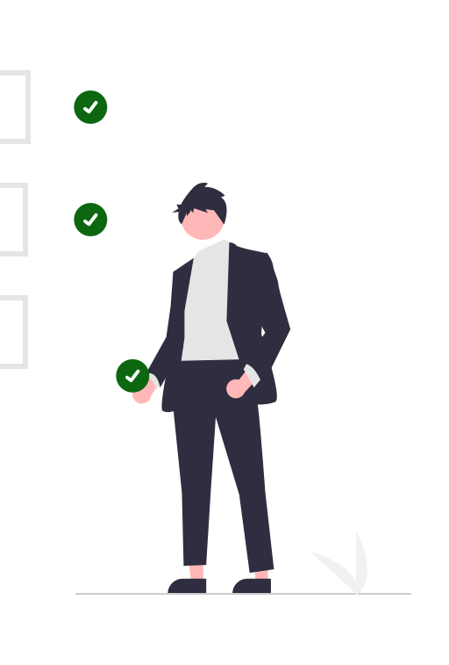
Objectives
G25
Provide a platform to,
Facilitate Job Search Process.
Facilitate talent acquisition Process.
Monitor and evaluate the progress of the event.

Slide 10





System Actors
G25
Company
Admin
Coordinator
Students/Graduates
Organizer

Slide 11

G25
Project Scope
Company
Companies can register in system.
Companies can publish their job advertisements.
Schedule and notify candidates for interviews based on their availability.
Company can update current availability of their vacancies.

Slide 12
Students
Student can register to the system.
Can view job advertisements and currently available vacancies based on their preference.
Students can submit their CVs to selected vacancies.
Can enable #OpenToWork feature.
Organizer
Publish notices.
Communicate with companies and students.
G25

Slide 13
Admin
Check and give the approval to students, companies when they registering in system.
Can manage system actors.
Can view reports about system activities.
Communicate with companies and students.
Publish Notices.
Coordinator
Check and give the approval to companies and students when they register in system.
Can check current Progress of the career fair.
Communicate with companies and students.
Publish Notices.
G25

Slide 14

G25
Out Scope
Facilitate video meeting conferences.

Slide 15







Quality Attributes
Usability
Performance
Reliability
Testability
Maintainability
Security

Slide 16



Proposed Technologies
G25
Web
Server
Database
React
Reusable components and Dynamic content
Node.js and express
Many Connections can be handled concurrently.
mongoDB
Best known for its flexible.

Slide 17


Project Management
Version control
Trello
Trello is the easy,free, flexible and visual way
Git
We can track changes in our code across versions.

Slide 18

G25
Feasibility Study

Slide 19


G25
Technical Feasibility
Team members have experiences with using this technologies.
Hosting in UCSC Web Server.
Developers have enough knowledge and hardware to work with these technologies.
Operational Feasibility
Better platform to connect the Companies,students with PDC.
We will create interactive UIs for increasing usability.
All actors in system get the notifications about current status.

Slide 20


G25
Legal and Ethical Feasibility
Confidential data will not be misused or provided to third parties.
Would not break any rules or regulations under the laws in the country.
Economical Feasibility
Hosting in UCSC server.
Development will be done mostly using open-source software and service.

Slide 21

Time Estimation
G25
The project is expected to be completed in 10 weeks.
Estimated man-hours for project completion:
Weekdays working hours = 3 hrs
Weekend working = 6 hrs
Number of members = 5
Man-hours per week = (3 + 6)*5 = 45 hrs
Estimated number of weeks = 10 hrs
Estimated total of man-hours = 10*45 = 450 hrs

Slide 22
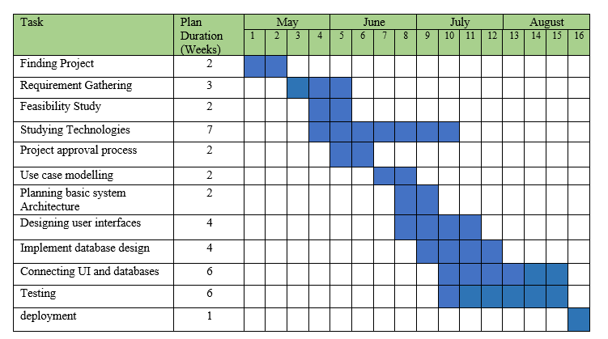
Schedule Feasibility
G25

Slide 23

Thank you!
G25

